Slide 1
Art Bible
Overview of “Ah! Zombies!”,where the player is put into a cramped gauntlet, and must fend of waves of zombies. By Daniel Sohler

Slide 2
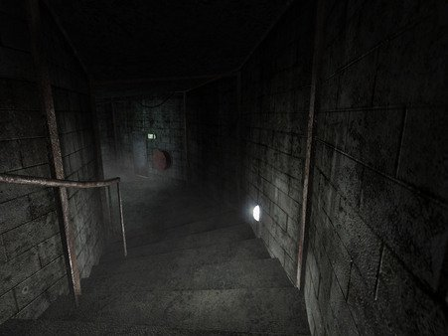
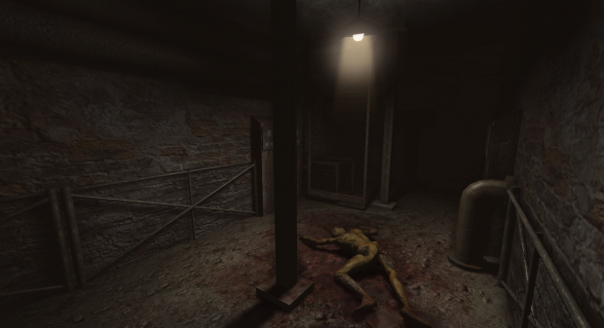
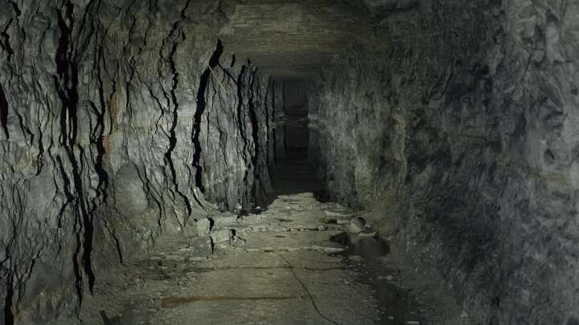
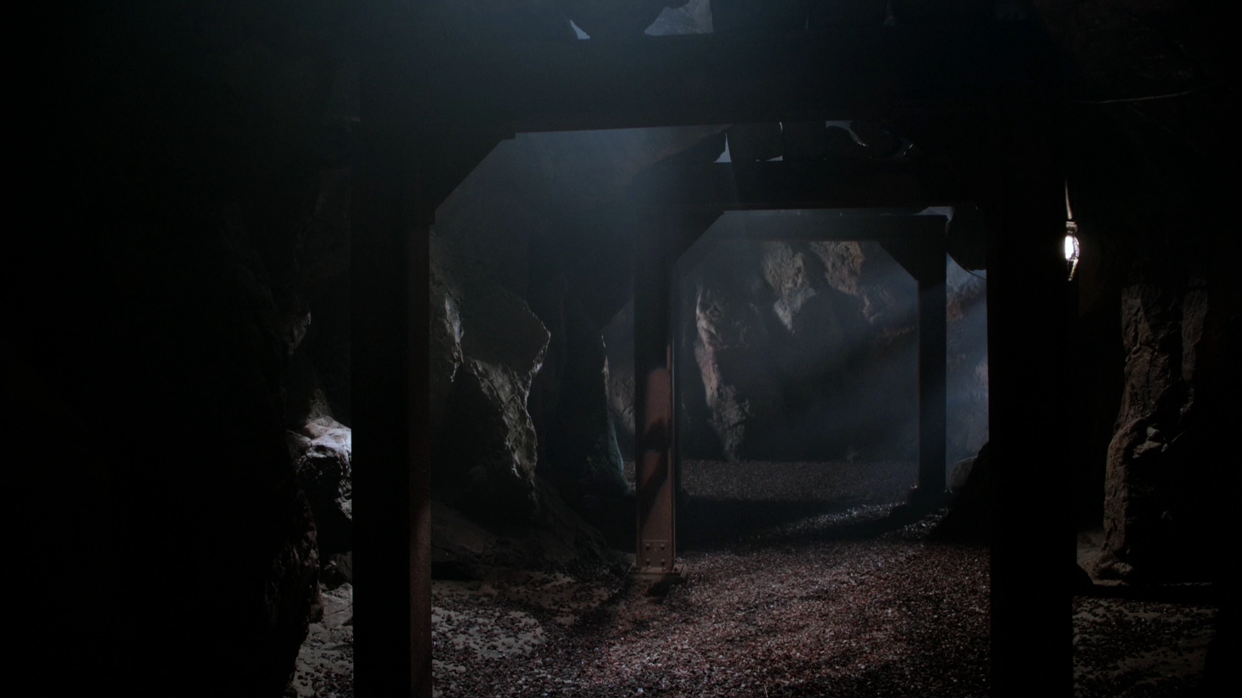
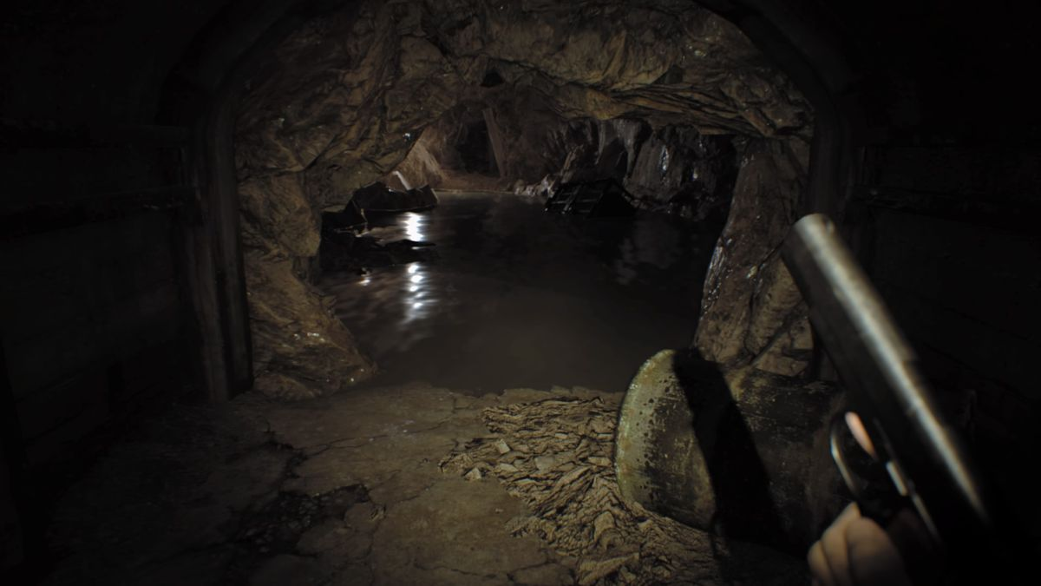
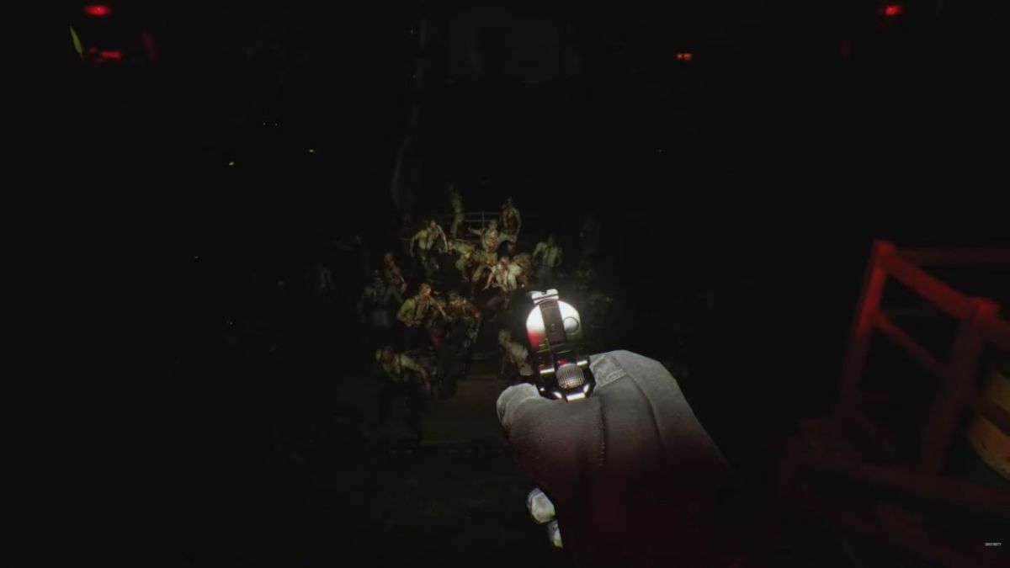
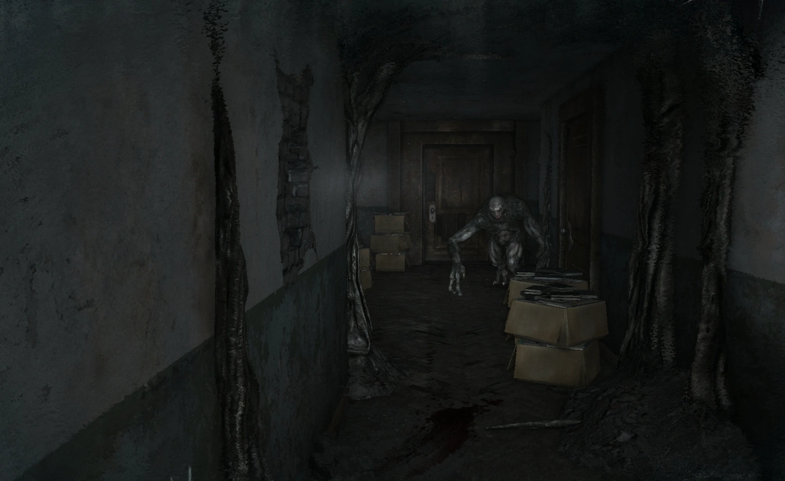
Mood Board
Cramped, confined
Dark, obscured
Semi Modern, Gritty

Slide 3
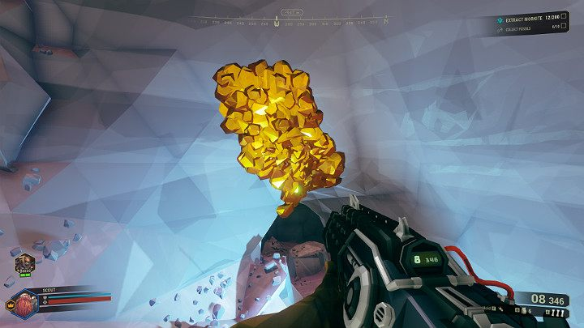
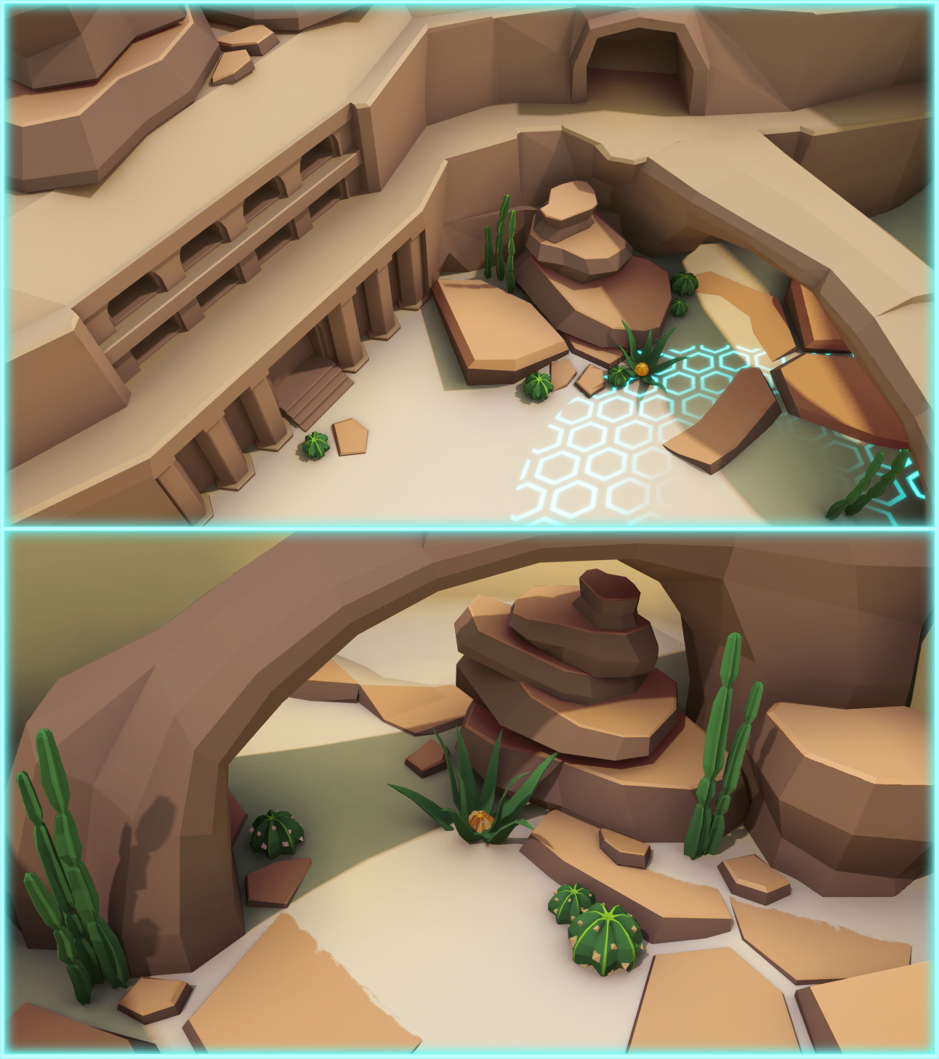
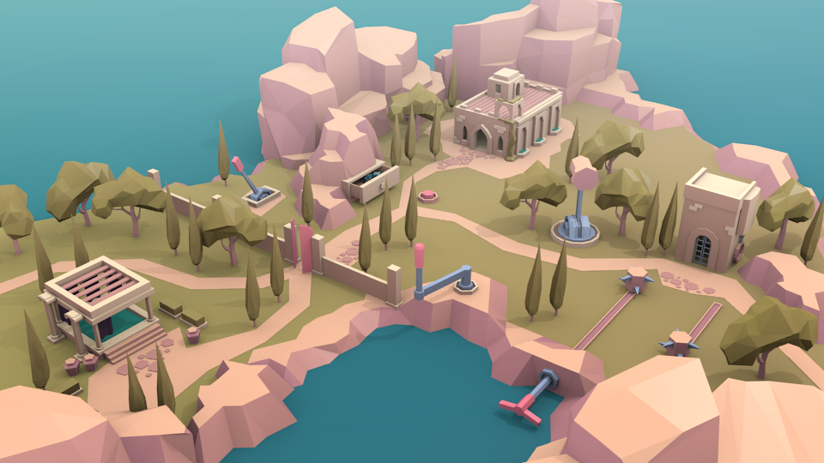
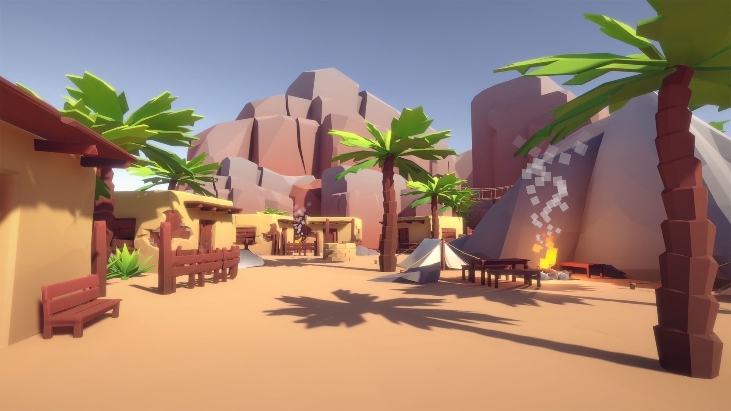
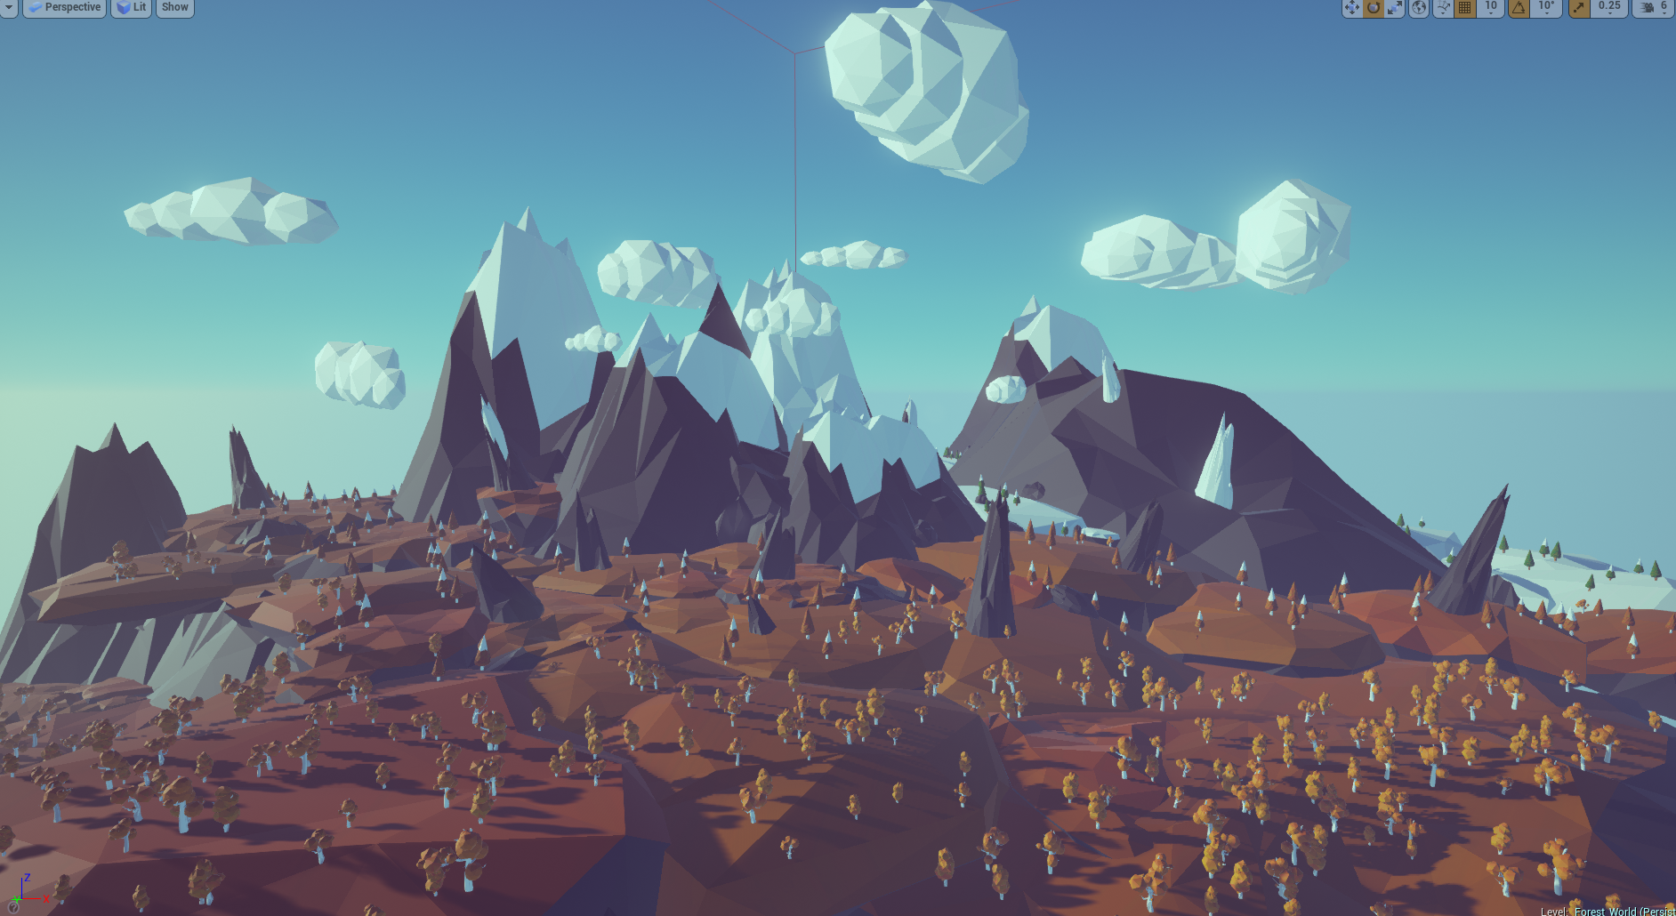
Art Style
Low poly, simple texturing.
Flat colours
Angular geometry

Slide 4
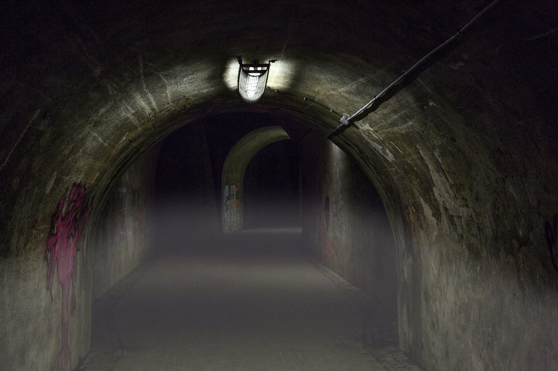
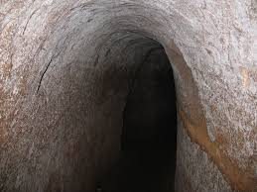
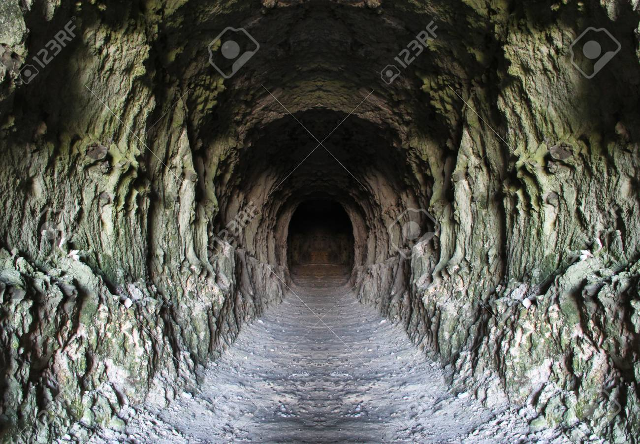
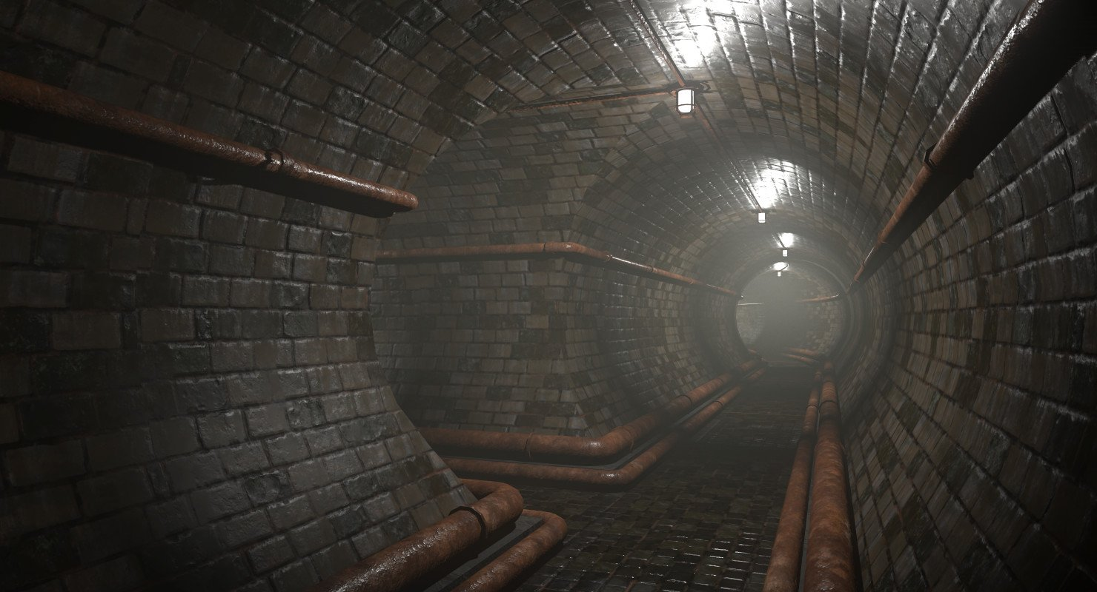
Environment/Atmosphere
Exposed, jagged rock.
Dark, damp, cramped atmosphere.
Light fog in tunnels.

Slide 5
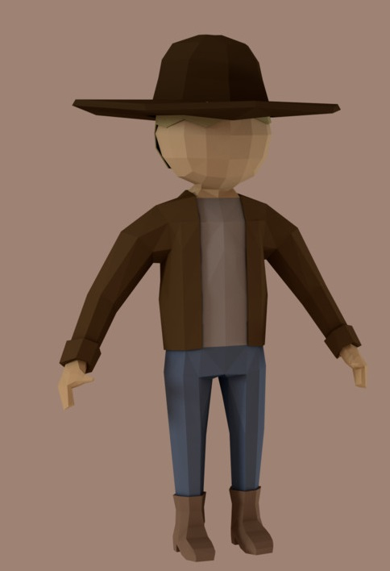
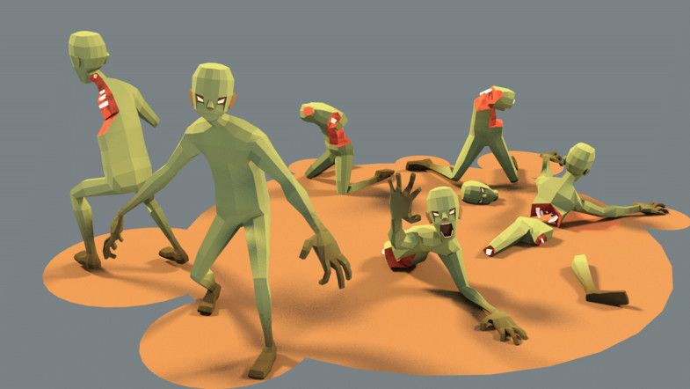
Characters
Zombie, has no mouth. Comes in 3 types: Default: Green Fast: Light Green Heavy: Dark Green
Player, cowboy. Looks semi modern, has a shotgun.

Slide 6
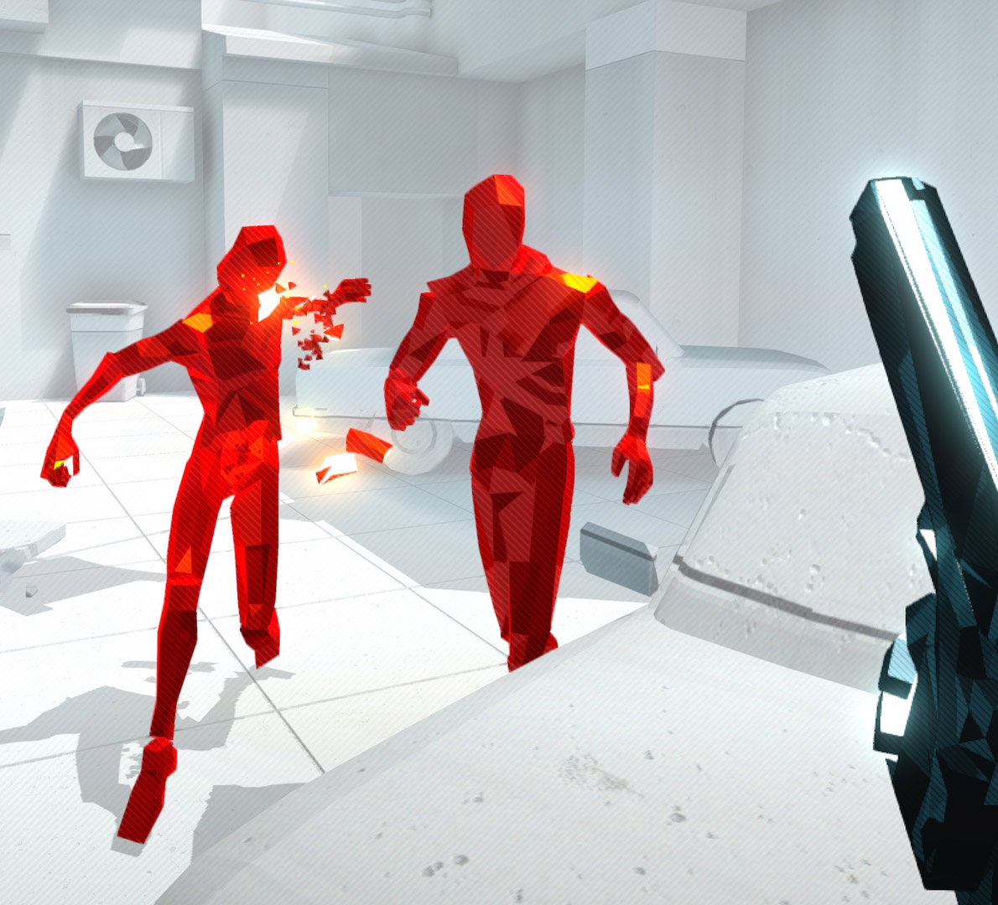
Level of Detail
Low level of detail, focus on model geometry.
Materials to reflect light, highlights lighting.

Slide 7
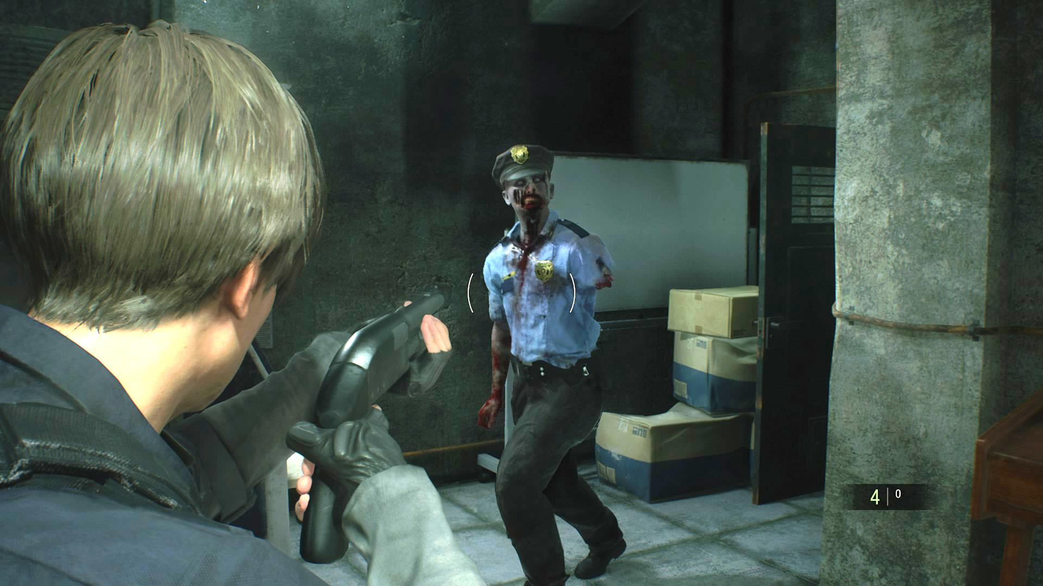
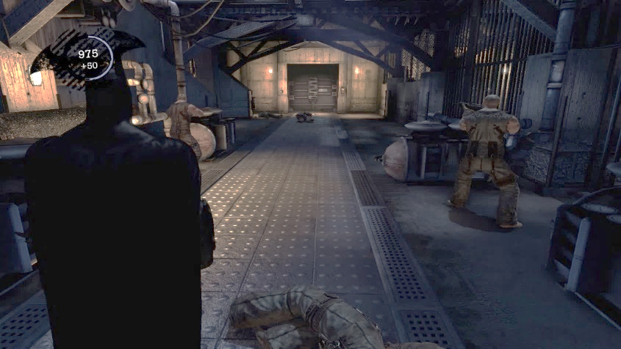
Camera
Over the shoulder, third person.
When aiming, sight of the player should follow down the shoulder + gun.
More behind player when not shooting.

Slide 8
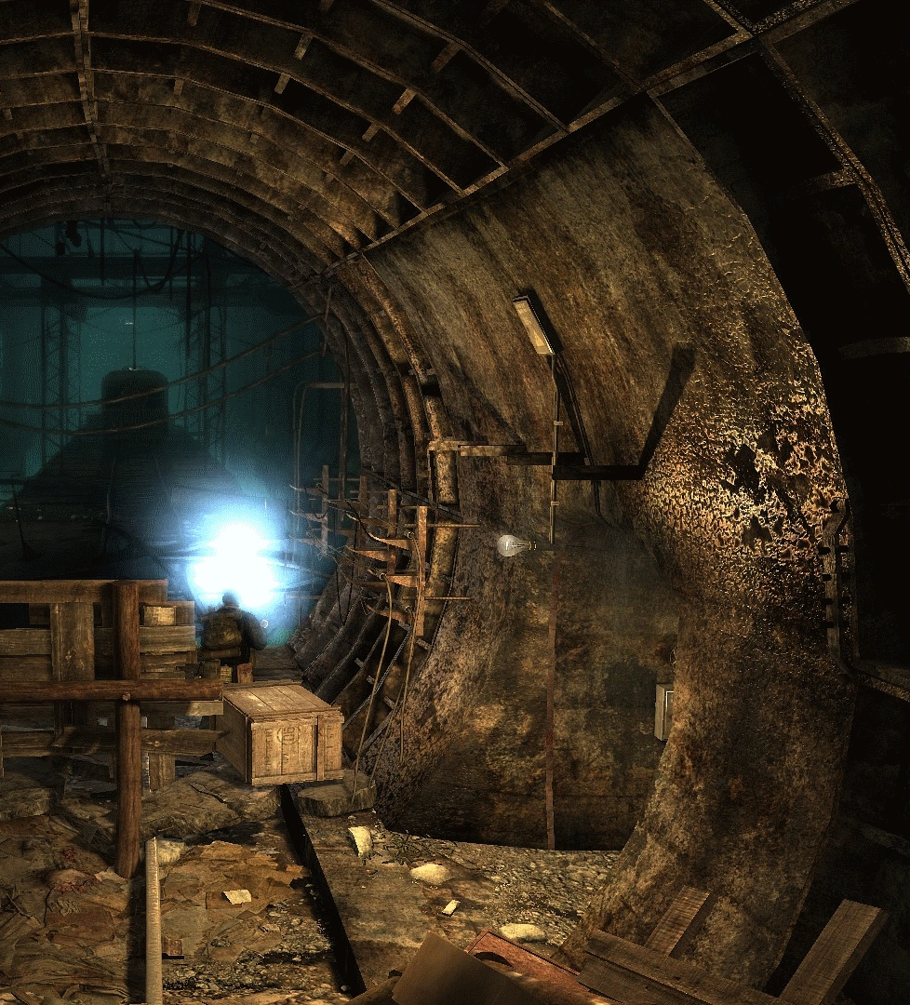
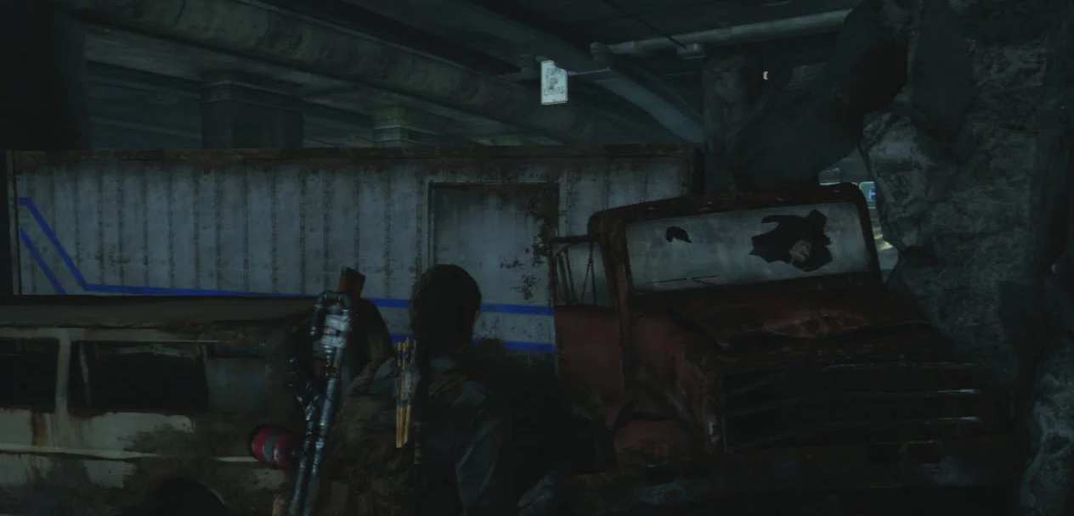
Lighting
Dark, but not pitch black, visible without light source.

Slide 9



Colour Palette
Dark colour palette for the environment. Aged stone and worn metal.
Sickly green colour palette for the zombies/enemies.
Warmer, faded browns/orange for player and ammo.

Slide 10

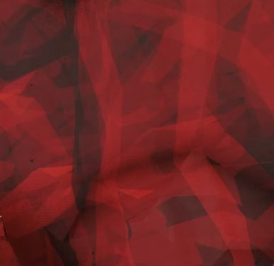
Texture and Surface
Low texture details, flat texturing.
Surface will be smooth and lacking depth. Not a focus of the art style.

Slide 11
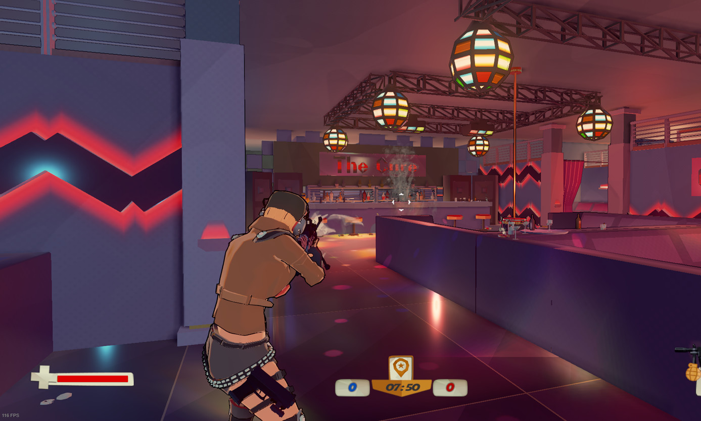
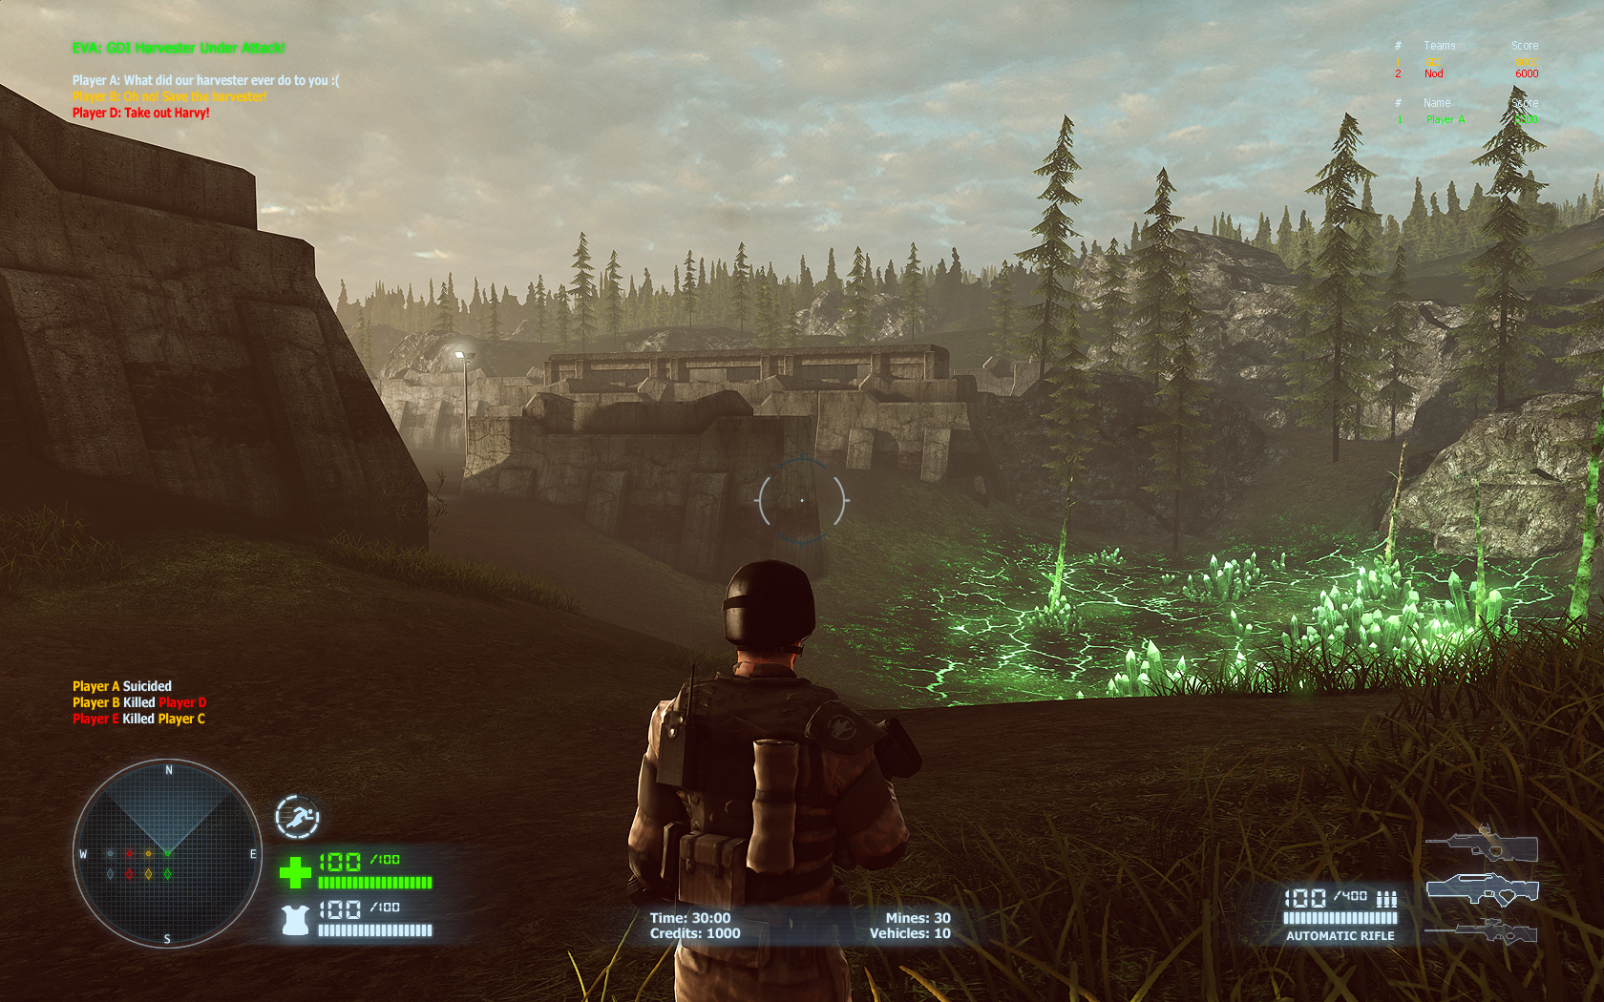
User Interface
At bottom & center of screen. Shows ‘Health’ and ‘Ammo’.
Counter on the top left showing enemy count.
Far away from players main line of sight on screen to avoid confusion.

Slide 12
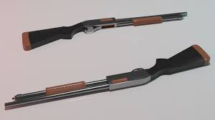
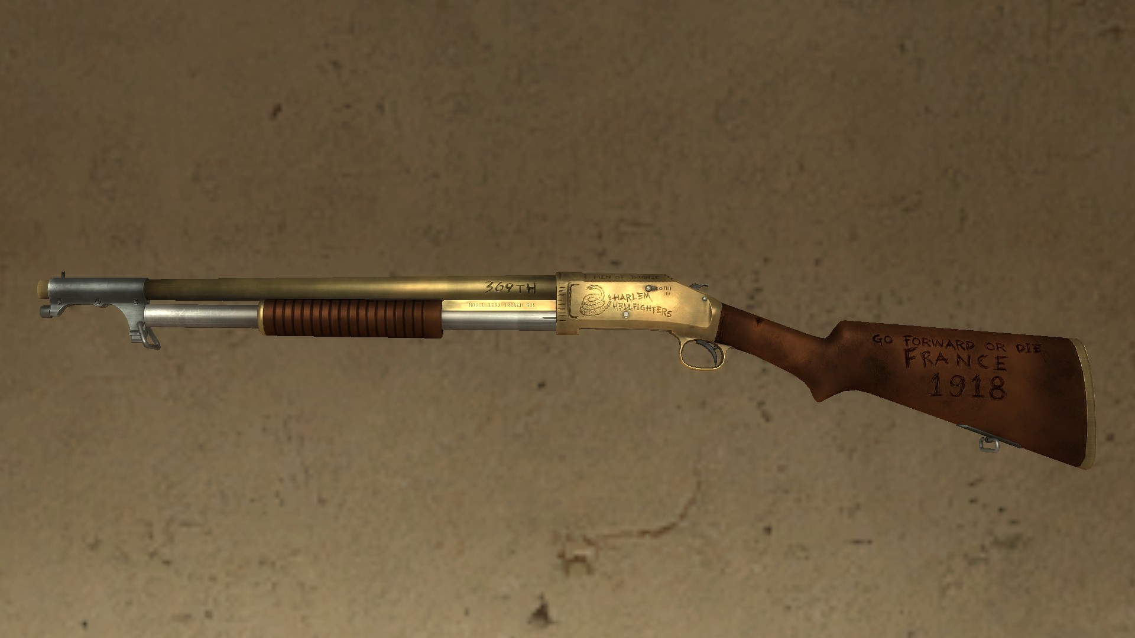
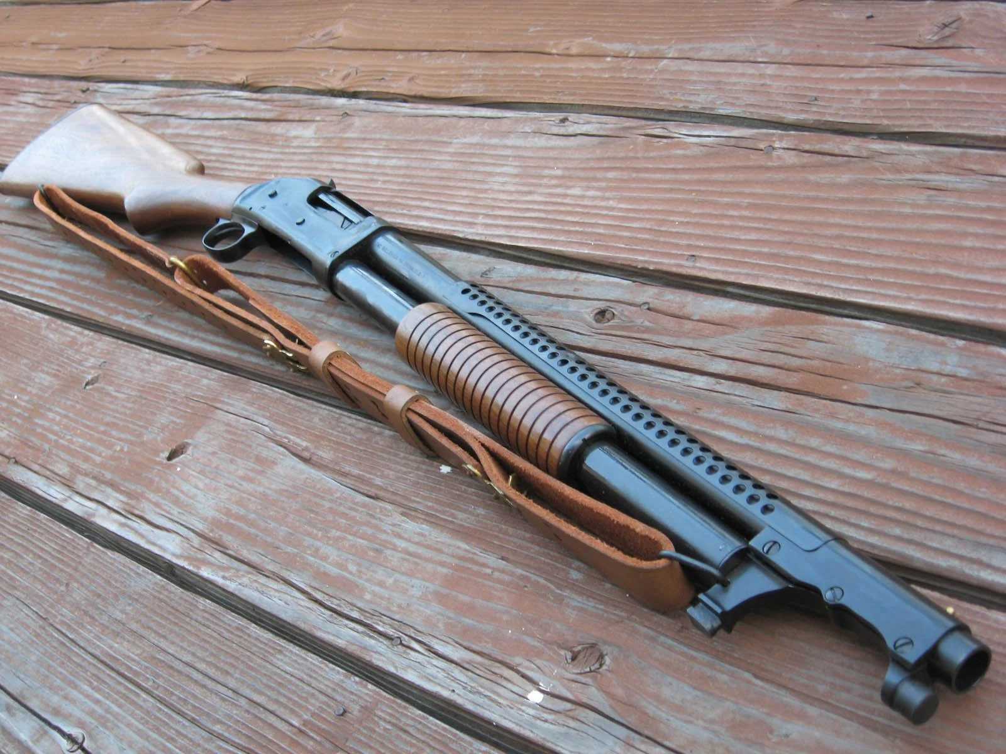
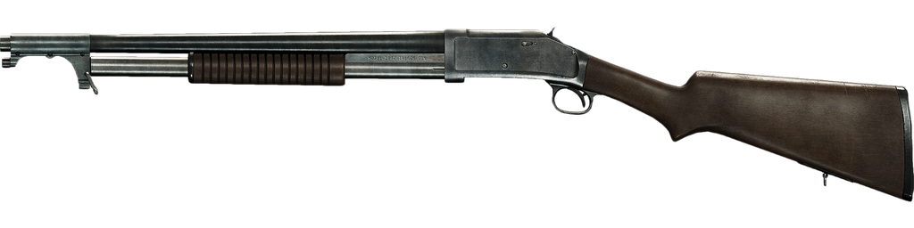
Key Asset: Shotgun
Design: WW2 Trench Shotgun
Role: Player's gun, always in view of camera.
Dimensions: 70cm long, 16cm wide, 22cm tall.
Materials: Wood for stock + slide. Metal for barrel + hammer + trigger.
Details: Slightly worn, no animations, no sling,
Poly Count:

Slide 13
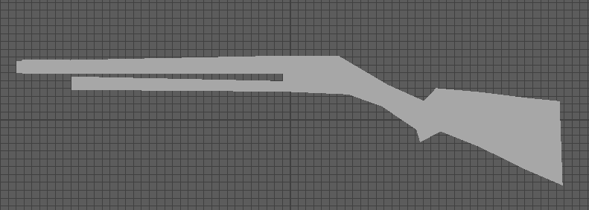
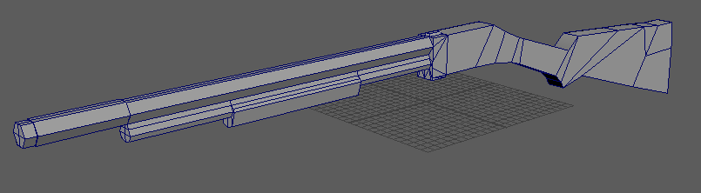
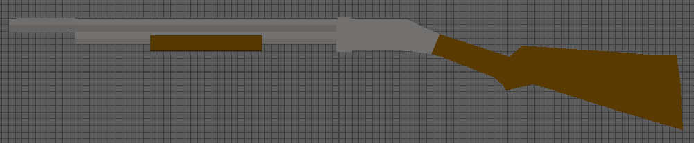
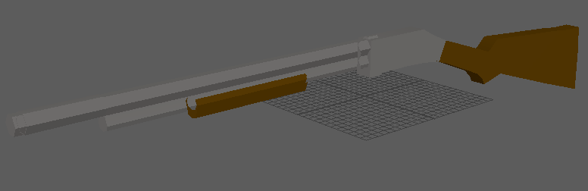
Key Asset: Shotgun
1st pass, all extruded out from far right.
2nd pass, made up of 3 combined parts.
Textured Ver.

Slide 14
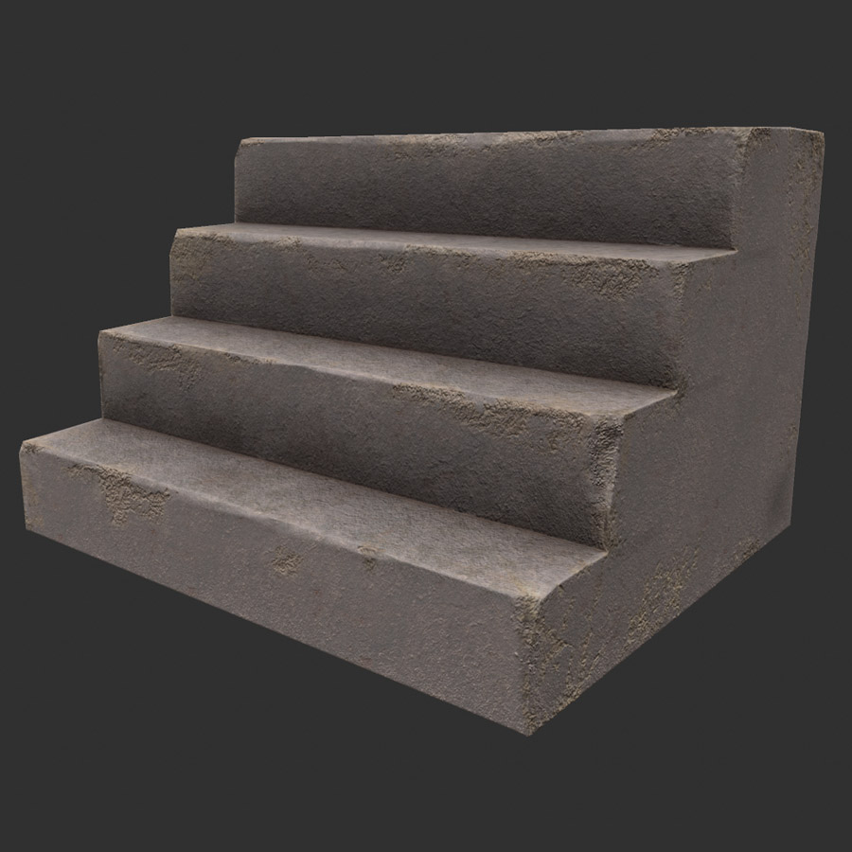
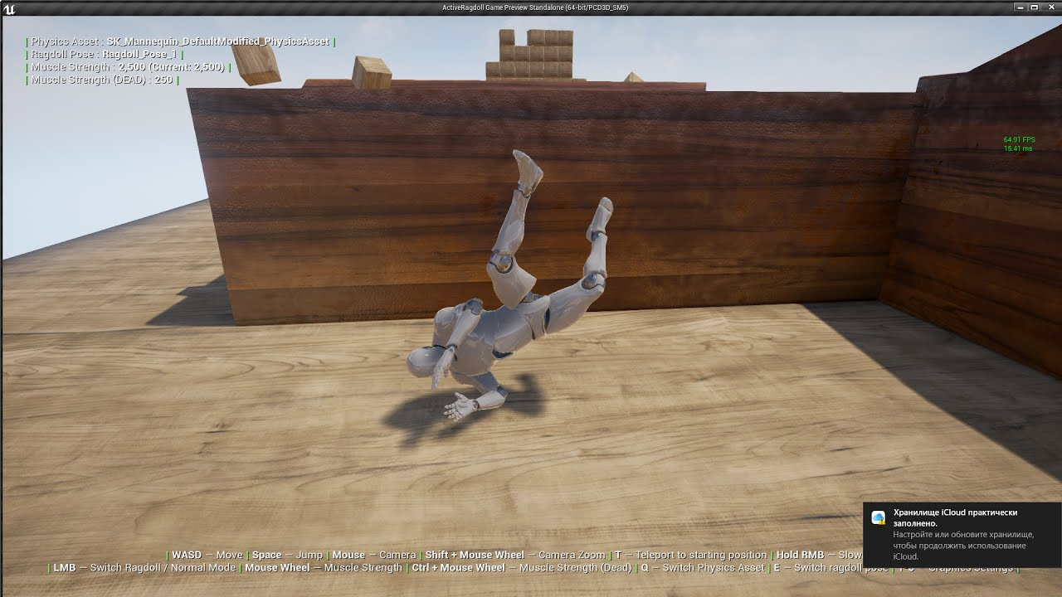
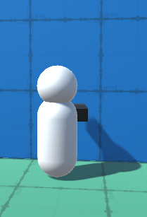
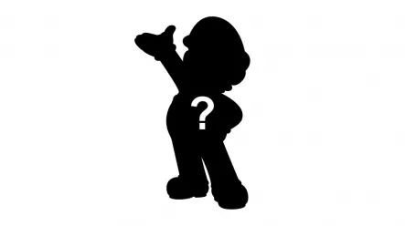
Design Rules
No change in elevation: stairs, ramps, elevators ect.
No physics objects: ragdolls, rubble ect.
Player is 1.40m tall.
Clear silhouettes of objects (visible in darkness)
1.4m

Slide 15
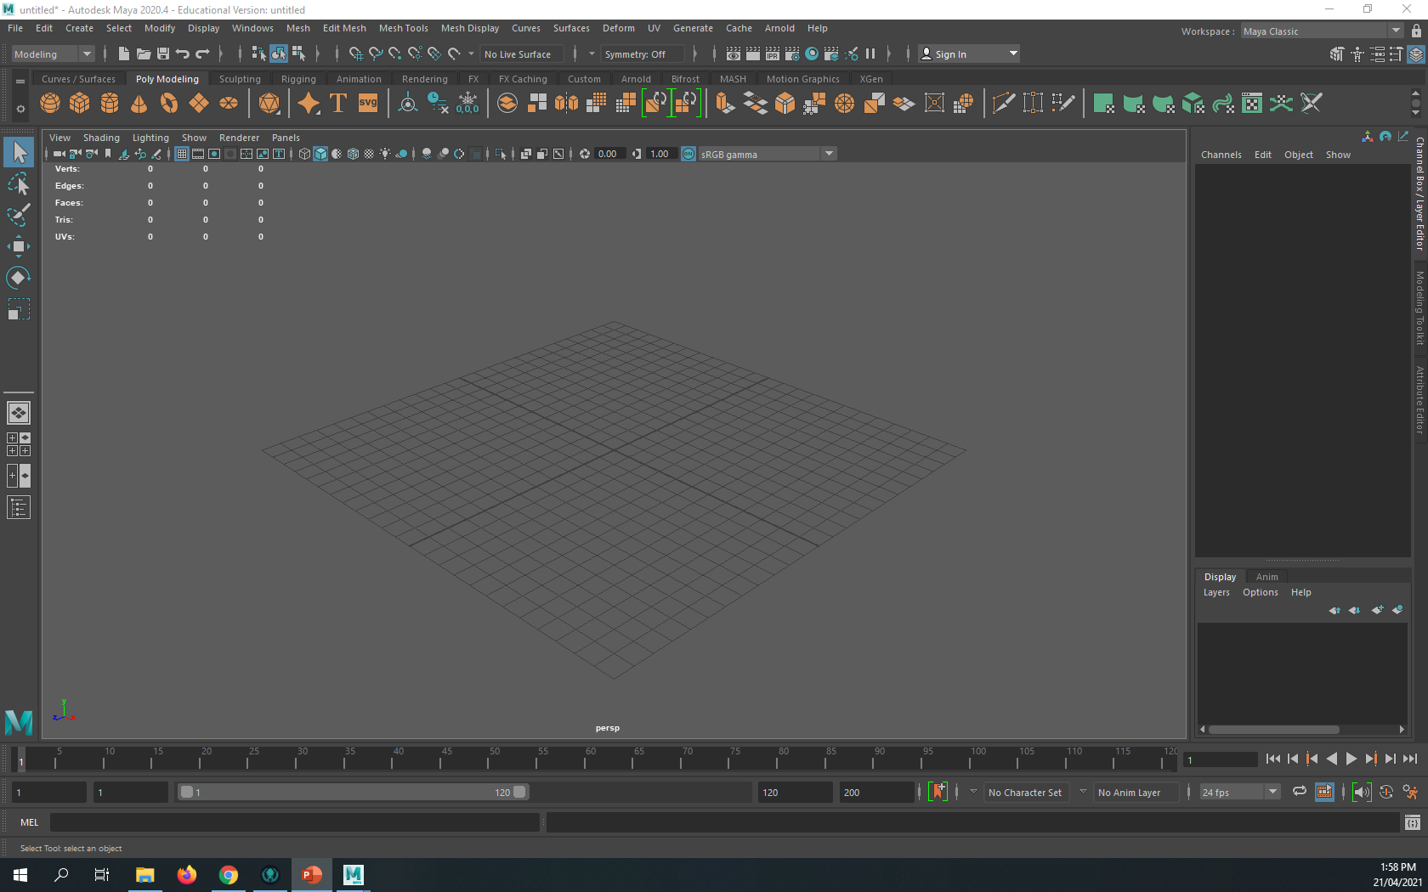
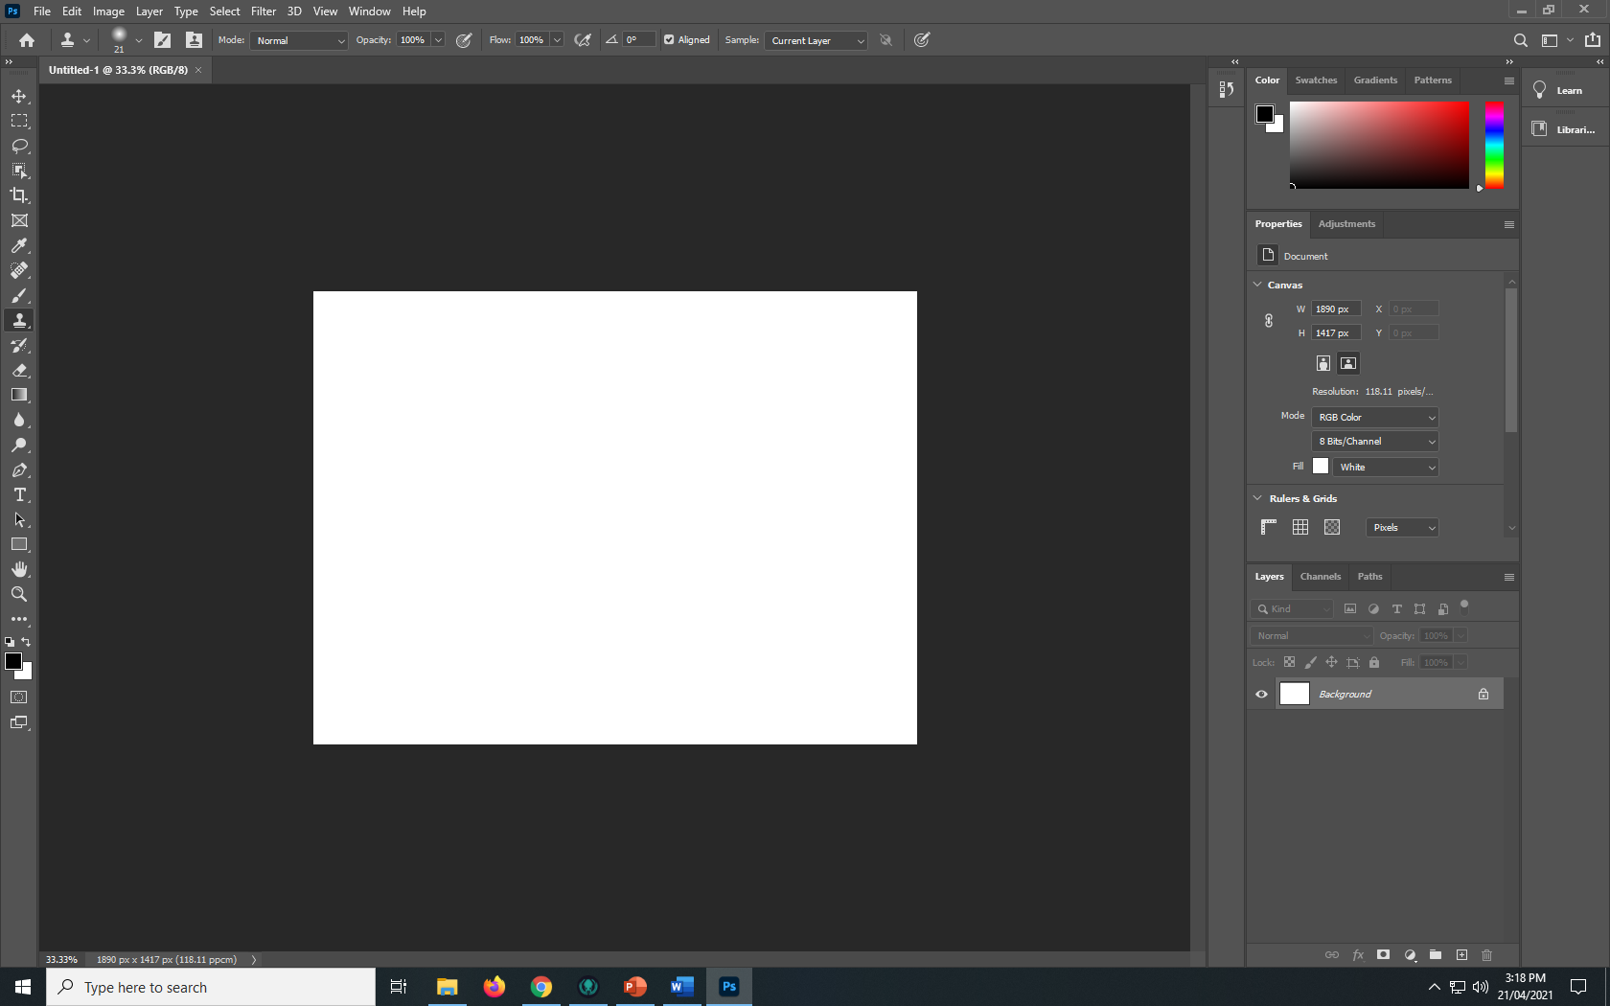

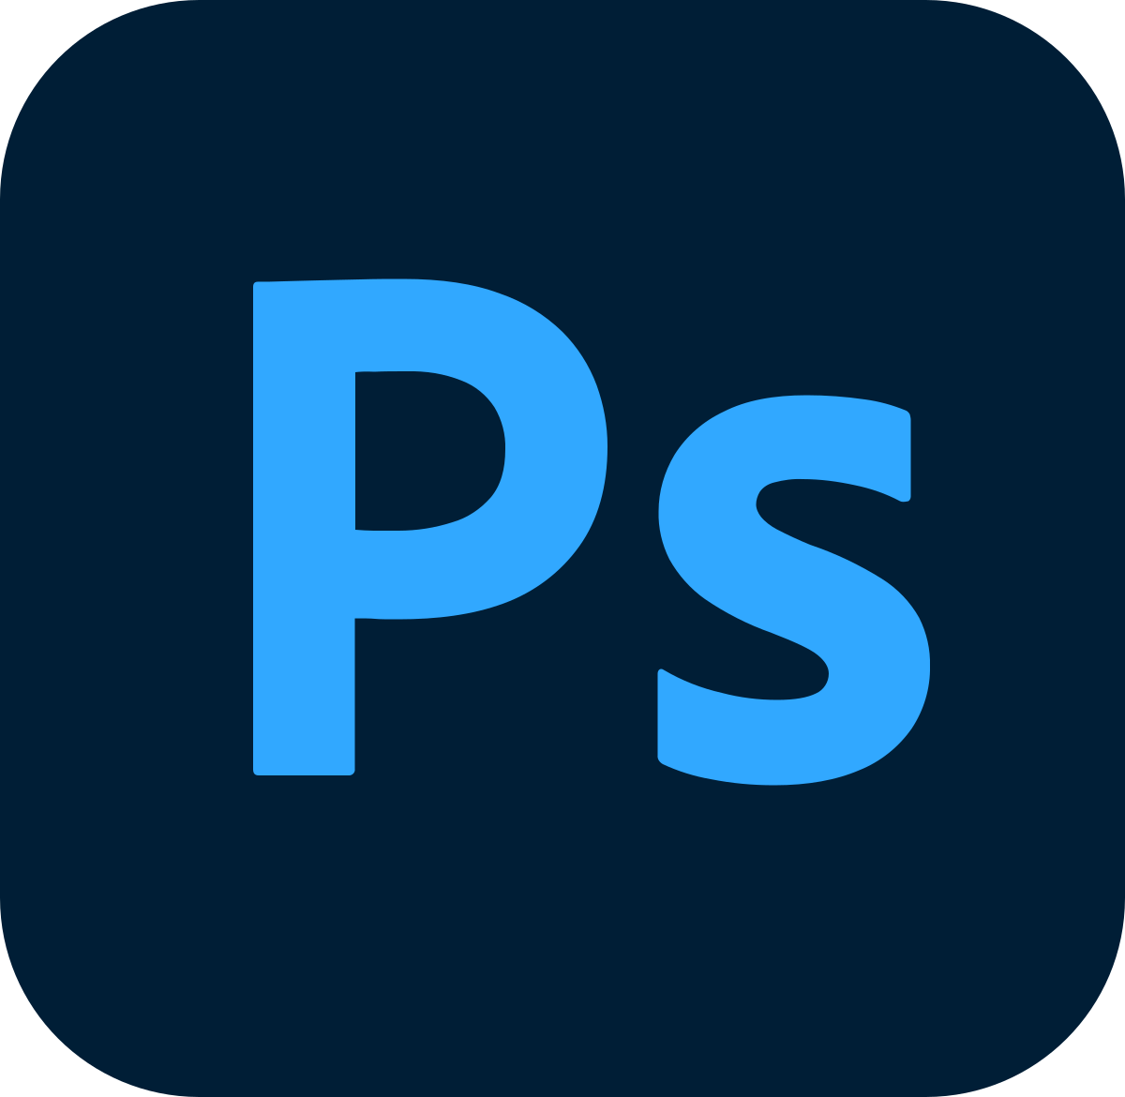
Art Tools
Program for Modelling: Maya
Program for Texturing: Photoshop
Model
Put in game
Redo-Model
Texture
Finish

Slide 16
Technical Guidelines
Platform: PC File Formats: .PNG, .mb (Maya Binary) Folder Structure: Textures = Ah!Zombies!/Assets/Custom_Assets/Textures/[texture in question] Materials = Ah!Zombies!/Assets/Custom_Assets/Materials/[material in question] Models = Ah!Zombies!/Assets/Custom_Assets/Models/[model in question] Texture Resolution: 512x512

